Slide 1
Encompass360Conditions
SindeoMortgage Operations

Slide 2
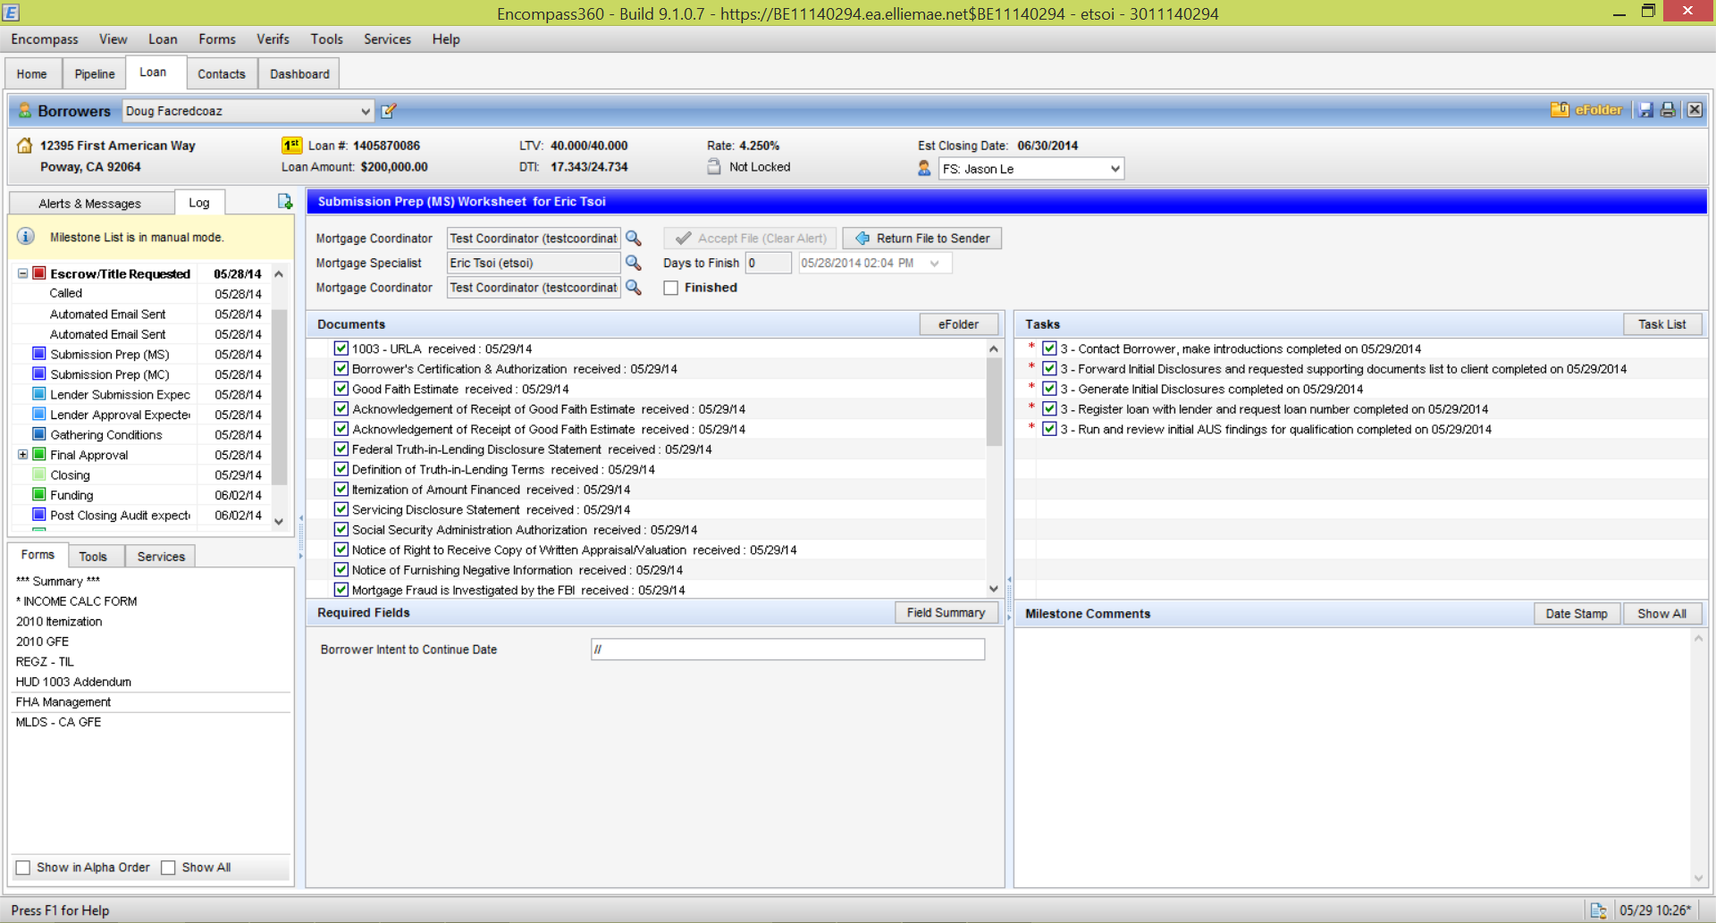
Button to openeFolderto access the conditions

Slide 3
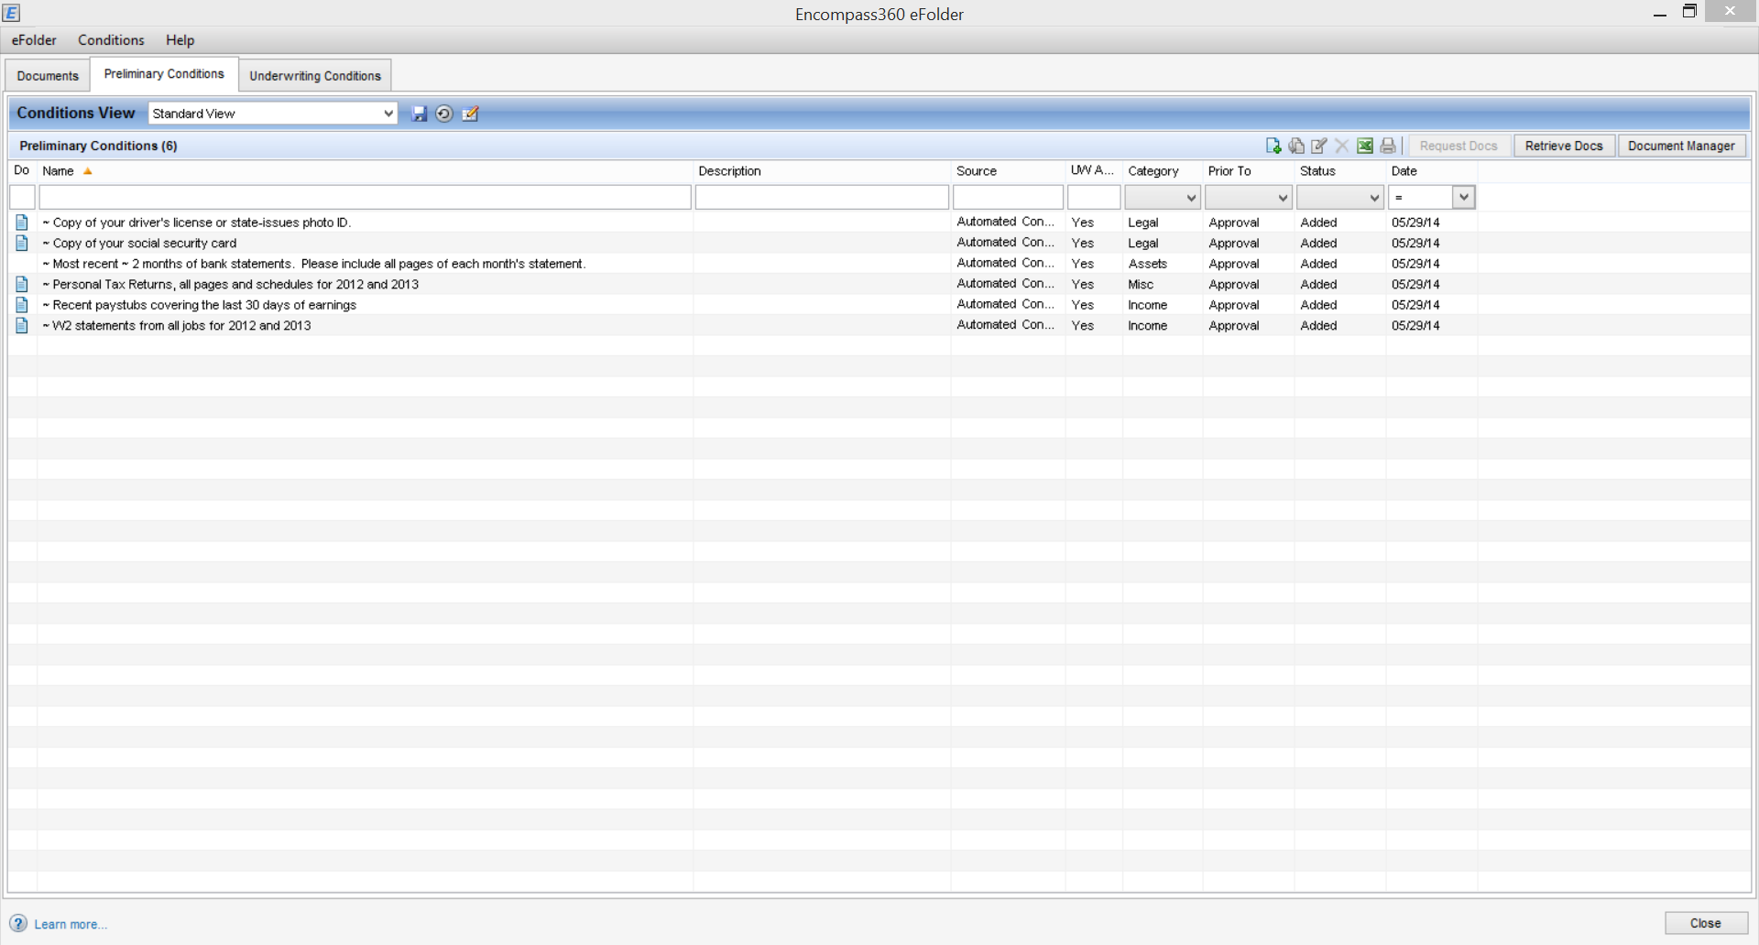
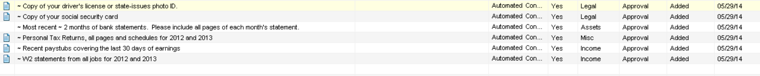
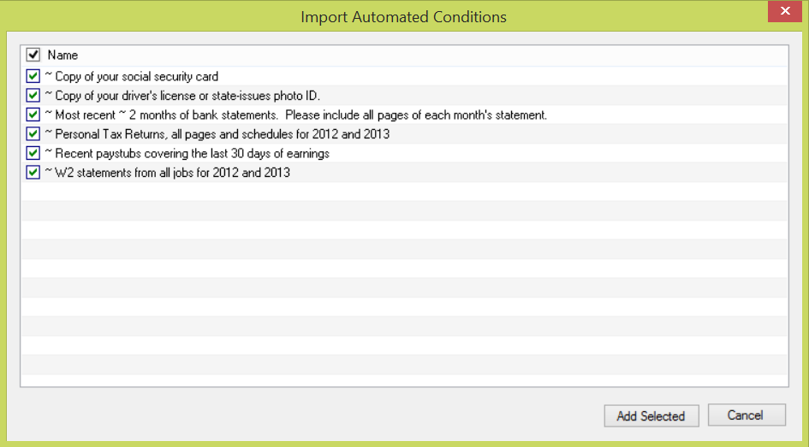
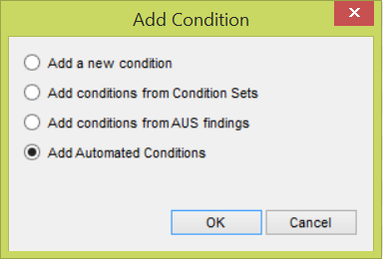
Step 1. Select “Preliminary Conditions” tab.
Step 2. Button to add conditions
Step 5. This is what should be shown after you import the automated conditions from step 3.
Step 3. Window that open up. Need to select “Add Automated Conditions” to add a pre-determine set of conditions base on the borrower data entered.
Step 4. Window that pop up once you select “Add Automated Conditions”. Just click “Add Selected” to populate the Prelim Conditions.

Slide 4
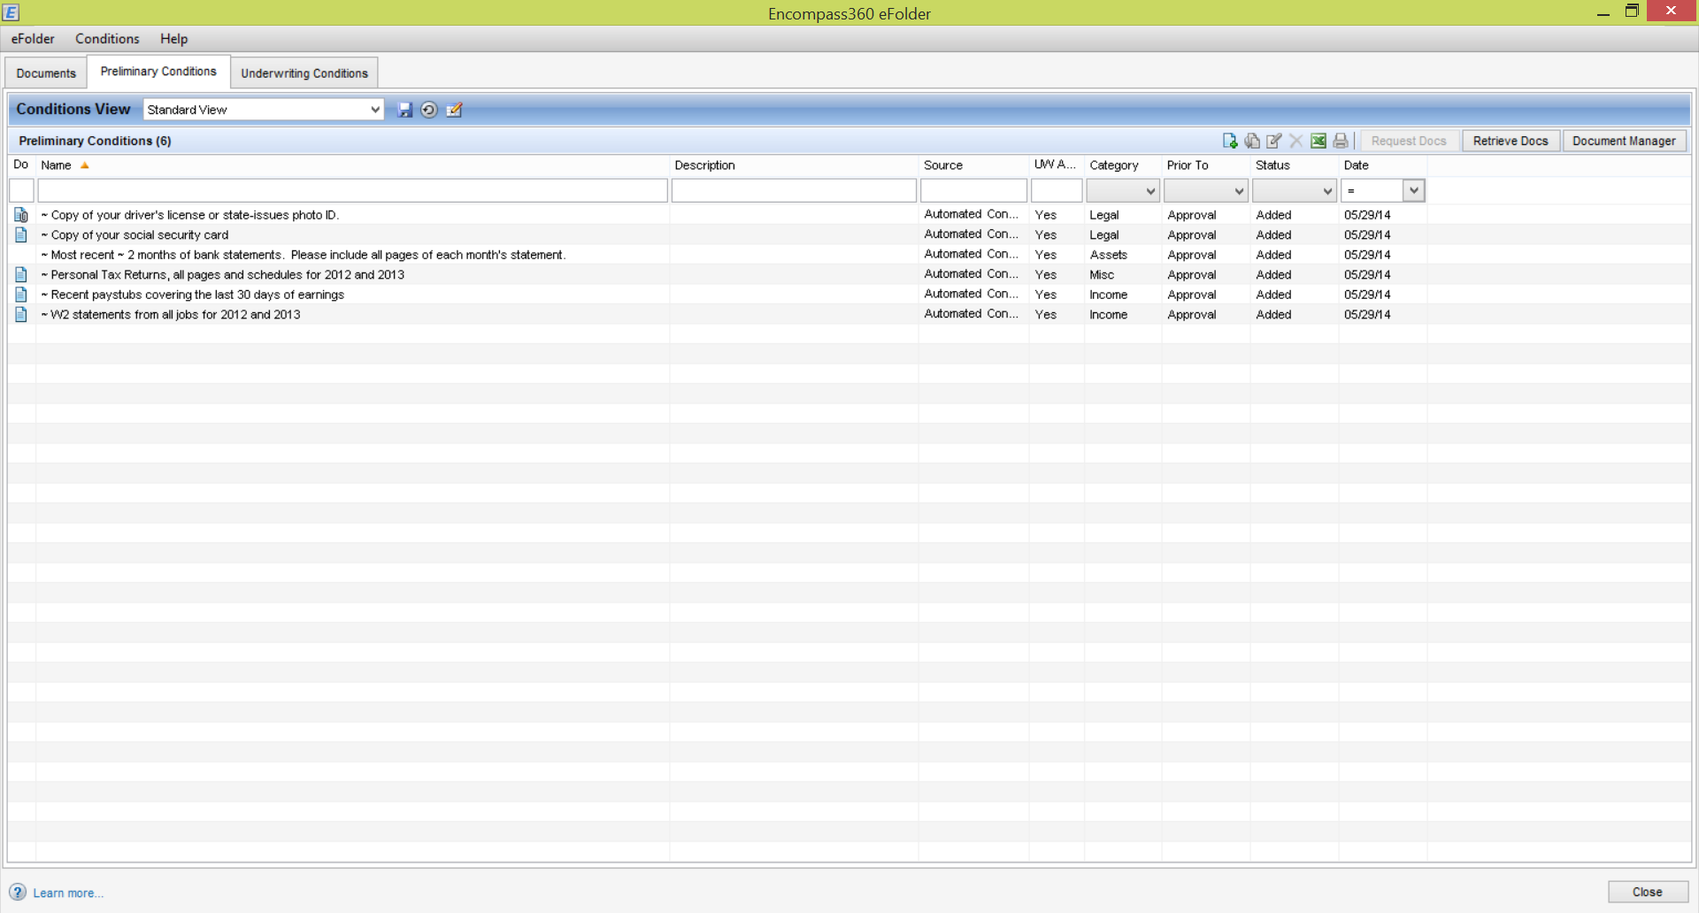
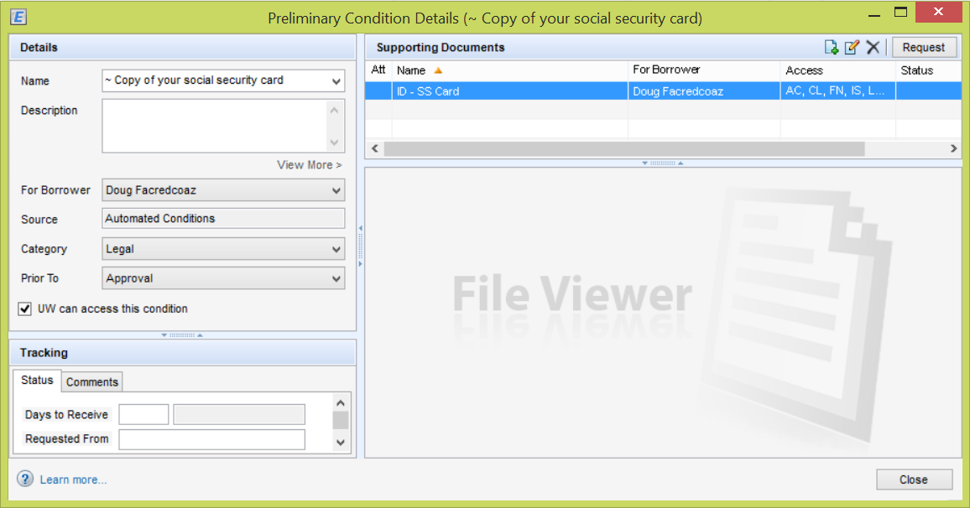
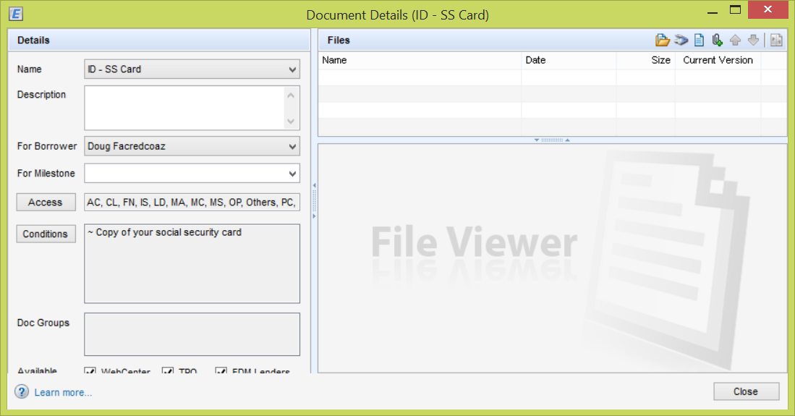
Step 1. Double click to open condition detail screen. See below panel for Condition Details screen.
Step 2. Double click to open Supporting Documents detail. See right panel for Document Details screen.
Step 4. Once the file is added. The icon will change to this to reflect there is a document attached to this condition.
Step 3. Click to open browser menu to add a file to this condition.

